Slide 1
Local Biocontrol Options and Weed Identification workshop

Slide 2
Cylindropuntia Pallida (Hudson Pear white spine) - Dactylopius tomentosus (californica var. parkeri’ lineage)

Slide 3
Cylindropuntia prolifera (Jumping Cholla) – Dactylopius tomentosus (califonica var. parkeri’ lineage) shares the same variant as Hudson Pear white spine

Slide 4
Cylindropuntia tunicate (Brown spined Hudson Pear) – (Dactylopius tomentosus acanthocarpa x echinocarpa’ lineage)

Slide 5
Cylindropuntia fulgida (Boxing glove cactus also known as Coral cactus) - Dactylopius tomentosus (cholla lineage)

Slide 6
Cylindropuntia imbricata (Devils rope pear) – Dactylopius tomentosus (cylindropuntia lineage)

Slide 7
Cylindropuntia spinosior (Snake Cactus) – Dactylopius tomentosus (bigelovii’ lineage) Opuntia aurantiaca (Tiger Pear) and Opuntia elata (Riverina Pear) – Dactylopius austrinus and cactoblastis cactorum Opuntia monacantha (Drooping and smooth tree pear – Dactylopius ceylonicus Opuntia robusta (Wheel Cactus) – Dactylopius opuntiae

Slide 8
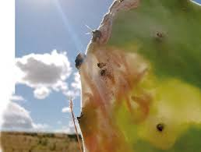
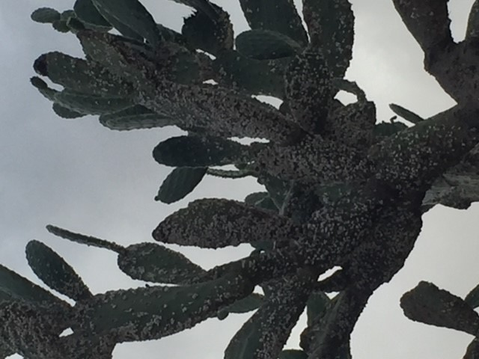
Opuntia tomentose (velvety tree pear) – Dactylopies opuntiae and Opuntia stricta (Common prickly pear) – Dactylopius opuntiae and cactoblastics cactorum Harrisia spp. (Harrisia cactus – Hypogeococcus festerianus Cylindropuntia leptocaulis (Pencil cactus) – C. leptocaulis

Slide 9
Anredera cordifolia (Madeira vine) – leaf beetle, Plectonycha correntina

Slide 10
Echium plantagineum (Patterson’s Curse)
Biological control
Biological control aims to limit the dominance of Paterson's curse to make it economically insignificant to farmers. Biological control is not an eradication program. It can take many years for the insects to reach their full potential and spread. Biological control requires more than one agent. For Paterson' curse there is a suite of four insects that have been released. Each insect attacks a different life stage of the plant. In some areas, these insects have caused a significant reduction in Paterson seed production.
Root weevil (Mogulones geographicus)
Flea beetle (Longitarsus echii)
Pollen beetle (Meligethes planiusculus)
Crown weevil (Mogulones larvatus) Description
Adults are 3.5-4 mm long, black and white with a prominant curved snout. Larvae are 10-12 mm long, creamy white in colour and bore into the crown. Attacked plants can be identified by a black discharge oozing from the crown

Slide 11
Pattersons curse, crown weevil damage

Slide 12
Heliotropium amplexicaule (Blue Heliotrope) – Leaf beetle (Deuterocampta quadrijuga)

Slide 13
Blue Heliotrope Biological Control -larvae

Slide 14
Blue Heliotrope – Biological control leaf damage

Slide 15
Pilot releases – Early Eeeeeeeeeeeeeeerly stages Lycium ferocissimum (African Box Thorn) rust fungus - Puccinia rapipes Conyza species (Flaxleaf fleabane) rust fungus – Puccinia cnici-oleracei

Slide 16
African Box Thorn Rust

Slide 17
African Box Thorn Rust

Slide 18
Riverina Pear – Opuntia etata Recently discovered Tiger Pear cochineal attacks Riverina Pear.

Slide 19
Blackberry-Rubus fruiticosus, Sawfly (Cane boring insect) from Europe funded by Meat & Livestock Australia

Slide 20
St Johns Wort (Hypericum perforatum)

Slide 21
St Johns Wort
St. John’s Wort in the north-west and Central west regions of NSW is flourishing in the current climatic conditions.
It will grow in a variety of areas including well established competing pastures, riparian areas, and bushland. St John’s wort contains the toxin hypericin, which causes photosensitisation in sheep, cattle, horses and goats. The skin damage associated with this problem leads to weight loss, reduced productivity and, in extreme cases, death.
One St. John’s wort plant can produce 30,000 seeds annually.
It is important that all known infestation sites are regularly monitored. All new plants must be treated before seed set, as every plant left untreated has the potential to produce thousands of new plants.
The best way to control St. John’s Wort is to take an integrated control approach. Heavily graze areas with infestations in the winter period to allow a good target for an effective spray program to be undertaken early Spring and Summer. Seeding and fertilising should follow to help get desirable pasture species established to help out compete new St. John’s Wort seedlings.
Biocontrol agents are present in some areas but to date have not been an effective tool to get large infestations und

Slide 22
St Johns Wort Biocontrol Agent Chrysolina quadrigemina Beetles (metallic bronze and metallic green)

Slide 23
Blast from the Past 7 October 1996
St John’s Wort End of an Era?
The money for research into the biological control of St John’s wort may have come to an end but the work is far from over. As is often the case in the past with biological control, once agents have been released and established at a few sites, and funding has come to an end, the agents are then left to spread naturally. But times are changing.
In October 1994, 120 nursery sites were set up to release mite (Aculus hypericin) St Johns Wort. 60 in Victoria and 60 in NSW.
The mite is microscopic and expectation of the mite was to deform stems and shoots, leading to dwarfing

Slide 24
Biological control, if successful, has the potential to reduce the long-term economic and environmental costs of traditional herbicide control methods for blue heliotrope. There has only been one biological control agent released in Australia for blue heliotrope. The blue heliotrope leaf-beetle (Deuterocampta quadrijuga) was first released in Australia in 2001. At high densities, leaf-beetles can completely defoliate blue heliotrope, with both the larvae and adults feeding on the leaves. The blue heliotrope leaf-beetle has the potential to build up population levels rapidly as each beetle lays 100s of eggs.

Slide 25
Parthenium Weed - Hay, Grain, Livestock and Machinery

Slide 26
Key message when thinking of biological control methods *make sure your weed species is 100% identified. In doubt or unsure contact your local weed officer *If you are introducing / spreading biocontrol make sure you have the correct lineage *I suggest only look at biocontrol options for large infestations or inaccessible terrain for spraying or mechanical methods

Slide 27
Andy Fletcher afletcher@cmcc.nsw.gov.au Senior Biosecurity Officer Castlereagh Macquarie County Council – Weed Control Authority, Warrumbungle, Coonamble, Gilgandra & Warren Shires – Central West NSW / Walgett Shire – North West NSW 0428 462 060 Thankyou for your time attending todays local biological control options and weed identification workshop.

